Slide 1
Component Analysis
This is a mathematical procedure that uses an orthognal transformation to convert a set of values of possible correlated M variables into a set of values of K uncorrelated variables called principal components.
It can be thought of as breaking down the internal structure of the data in a way which best explains the variance(major features) in the data
References:
http://en.wikipedia.org/wiki/Principal_component_analysis
https://www.youtube.com/watch?v=g5_tonFnfaQ

Slide 2
Eigen Eyes
The first step in finding out eigen eyes is to find the average of the images in the dataset
You then subtract the average from individual images and then find the covariance matrix.
The eigen values and eigen vectors of the co-variance matrix will be the eigen eyes.
References :
http://www.pages.drexel.edu/~sis26/Eigenface%20Tutorial.htm#Final%20Words
Notes:
The eigenvector with the largest eigenvalue is the direction along which the data set has the maximum variance. Meditate upon this.

Slide 3
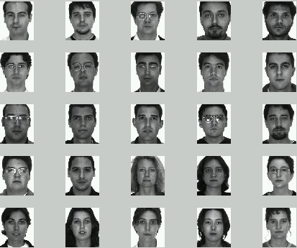

Slide 4
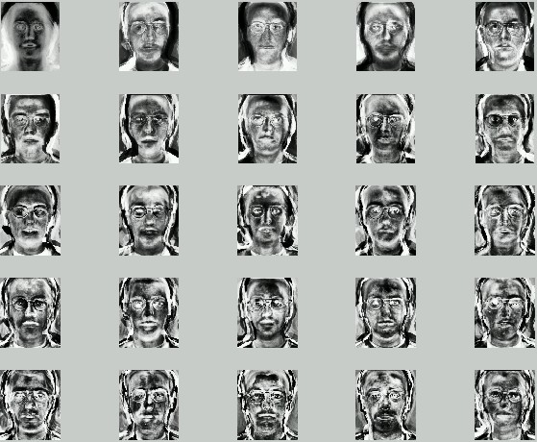
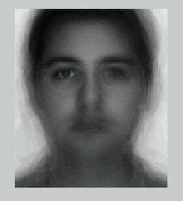

Slide 5
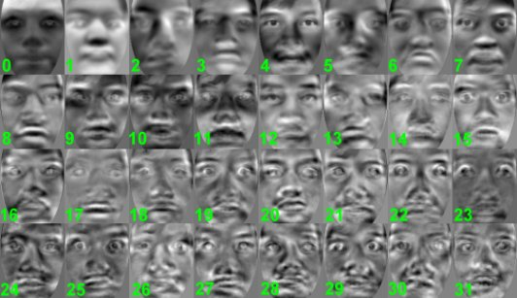

Slide 6
Recognition Procedure
From the data set of eye images we find the eigen-eyes and their respective eigen values.
The mean of the images in the data set is subtracted from the new image and is multiplied with the transpose of the eigen vector. This basically gives gives the weight for corresponding eigen vector in the image
The set of all these weights is the class of the image
The image is then reconstructed from the eigenvectors and their corresponing weights
This reconstructed image will not have the defect that the image contains
This when subtracted from the original image will return to you the defect in the image

Slide 7
Procedure
First we get a database of eye-images
The images then are resized and converted into grayscale images and numpy arrays
Then we find the mean of all the images
The mean is then subtracted from every image and then co-variance matrix is then found
The eigen values and the eigen vectors of the co-variance matrix gives the eigan eyes.

